Slide 1
Planned changes to report results for a single student
i
This manual shows you updates that will be delivered on September 23rd, 2020 on how you can report results for a single student.
Go to a student’s overview and click on a course to get to the view where you handle results for a single student. Here you can report and certify results for a student, just like usual.
These changes are planned for this site:
New! Summary
Summary of completed credits on the course (from all course versions)
New! Manage results
Use the button to report or certify results
Change: Results annotations
If there is results annotations on a certified result, there is an arrow to the left of the module code. Click on the arrow to see the annotations.
Change: See all certified results
Here is a summary of all the results the student has completed on the course.
Change: More information shows
In the overview of results, you can now see project title, examinated credits and a direct reference to decision documents.
Senast uppdaterad: 2020-09-18
Lathunden visar planerade förändringar i Ladok

Slide 2
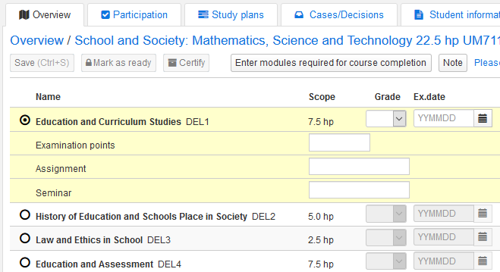
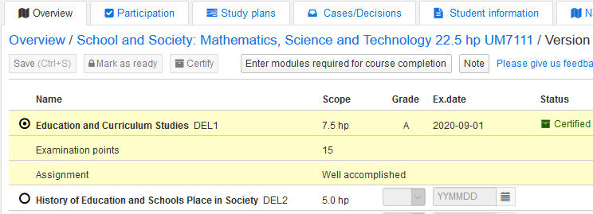
Report results annotation
When you handle results for a single student, it will now also be possible to see and handle results annotations.
When a module is marked, all results annotations that you can report on become visible. You will then be able to fill in results annotations.
When the result has been certified, you see the results annotations that were reported. If any of the fields for results annotations was left empty when reporting the result, that row does not show.

Slide 3
All fields on a result can be changed
It is already possible to change grade and examination date where you handle results for a single student. It will now also be possible to change all fields that can appear on a result (results annotation, title, examinated credits and reference to a grade document).
To change certified credits, you mark the result and choose: Select → Change certified result
It will now be possible to change all fields that appears in the result. Please note that:
You can only change results annotations that have already been filled in. If a field for results annotation has been left empty, the row will not show which means that you can’t fill in a result annotation at this point.
If the only change is a adjustment in a title, the change should be done in an errand instead (Case: correct title in result). If you change the title using an errand, only the title will be affected and not the result.

