Slide 1
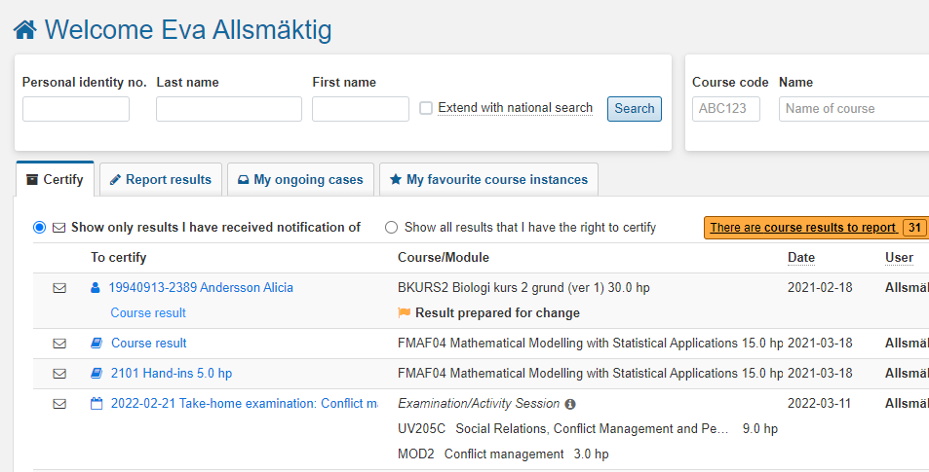
Certify results
Content | Page
Certify results | 1-5
Change or remove a result marked as ready | 6
You will receive an email when you need to certify results.
Find the results to be certified by:
Go to the home page in Ladok, and make sure that the tab “Certify” is selected
Click on the module, exam or course results to start certifying. Instructions continue on the following pages:
Module: page 2
Examination: page 3
Results of the entire course: page 4
A specific student: page 5
1
2
Last updated: 2022-09-12 Version of Ladok at the latest update: 2.0.0

Slide 2
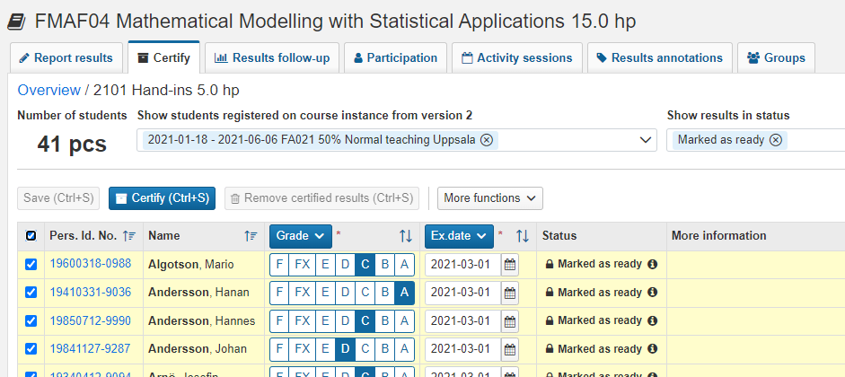
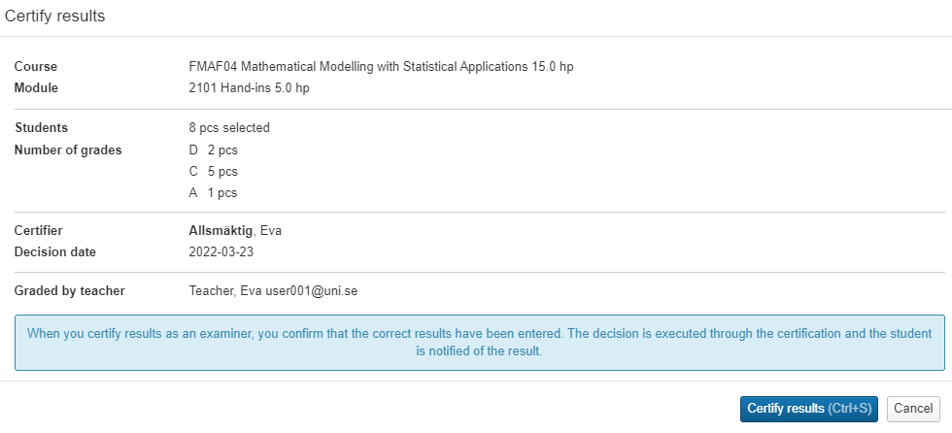
Certify results on module
When you click on a module, you will see the results marked as ready on the module
Review the results and check-mark the ones to be certified
Is the result incorrect? Change or delete results BEFORE certifying
Click on "Certify".
In the dialogue box: Click on "Certify results": Ladok may now request that you log in again.
You are now done with the certification and thus the decision of the results is made.
The students are automatically notified that they have new results.
2
1
3

Slide 3
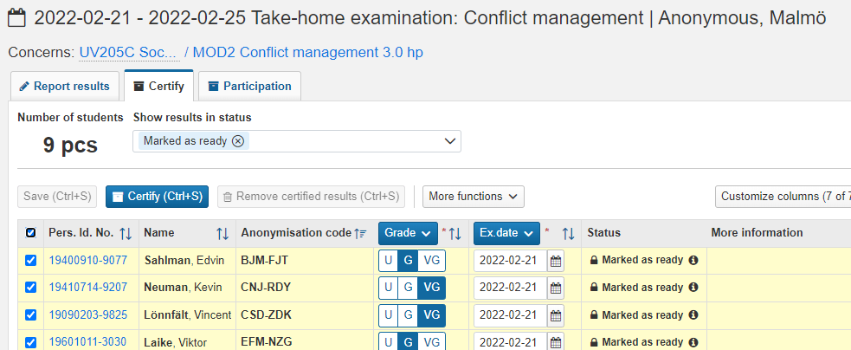
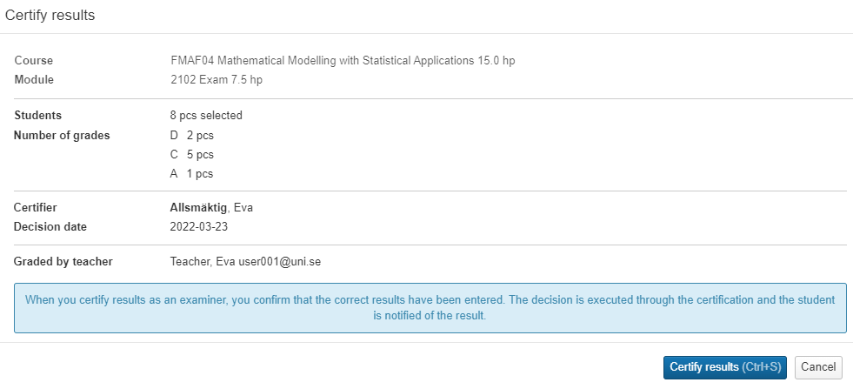
Certify results on an examination
i
Exam result = Module result
The exam that is set up in Ladok always concerns a module. When you report results on the exam, it is the grades on the module that are set.
When you click on an exam, you will see the results marked as ready
Review the results and mark the ones to be certified
Is the result incorrect? Change or delete results BEFORE certifying
Click on "Certify".
In the dialogue box: Click on "Certify results": Ladok may now request that you log in again.
You are now done with the certification and thus the decision of the results is made.
The students are automatically notified that they have new results.
The course(s) and module(s) to which the examination concerns. It is this module that the result is reported on.
2
1
3

Slide 4
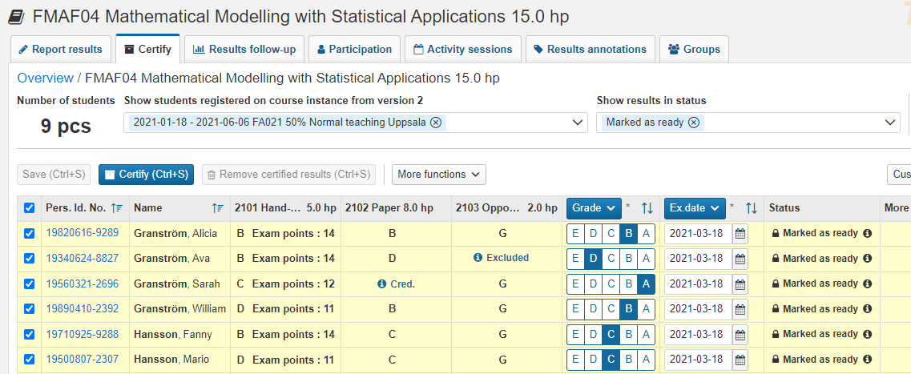
Certify results on the entire course
When you have clicked on "Results on course", you will see the results marked as ready listed together with the students' results on the course modules.
Review the results and mark the ones to be certified
Is the result incorrect? Change or delete results BEFORE certifying
Click on "Certify".
In the dialogue box: Click on "Certify results": Ladok may now request that you log in again.
You are now done with the certification and thus the decision of the results is made.
The students are automatically notified that they have new results.
Show / Hide columns
You can control which columns are displayed, click on "Customize columns" to e.g. hide modules that are not relevant to you now.
2
1
“CRED.“
If all or parts of the module have been credited, “CRED" is displayed. Click on the text to see more information.
“EXCLUDED“
If a module is marked with “Excluded", it means that the student has received results from different course versions (with different set of modules). Click on the student's personal identity number to see a summary of the student's results.

Slide 5
Certify results for a specific student
When you click on a student's name and personal identity number on the home page, you will be re-directed to a page where you can handle that particular student’s result on the course. This may by either a new result or a changed result you need to certify.
The result that you need to handle is marked in yellow.
Certify a new result
The grade and examination date (and any other information e.g. title or exam points) are shown in the row of the module.
Click on Certify to certify the result Ladok may request that you log in again.
Reject the result by clicking ”Options” → ”Remove marked as ready”.
Change the grade, date or any other information that is faulty by writing the new information in the row for the module. Save and then certify the result.
Certify a changed result
You will see the result that the student received previously. Underneath, in brighter yellow, you will see the changed result that needs to be certified.
Click on Certify to certify the result Ladok may request that you log in again.
Reject the result by clicking ”Options” → ”Remove marked as ready”.

Slide 6
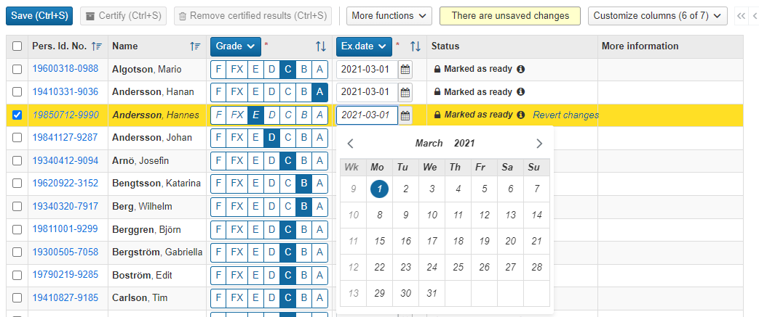
Change or remove results marked as ready
Change the result BEFORE you certify
If any of the results marked as ready are incorrect, you can change them before certifying.
Stay in the "Certify" tab and select another grade / examination date for the student in the list.
Click on "Save".
The change is saved and the result is now ready to be certified.
Remove marking as ready
If any of the students who have a clear mark should not have a result at all, you can reject it by removing the marking as ready.
Stay in the "Certify" tab and select the result you want to delete
Click “More functions" → "Remove ready mark for results".
Confirm in the dialog that opens
The marking as ready is removed. The result is now in status draft and can be handled by the person reporting on the course again.
2
1
2
1

