Slide 1
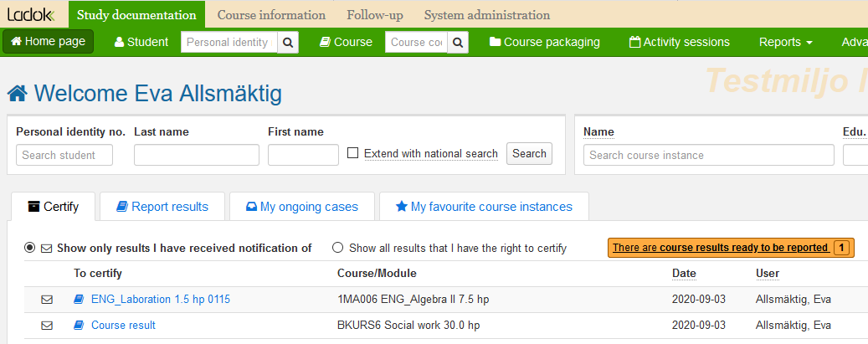
Certify results for a single student
You will receive an e-mail when you need to certify results.
Log in to Ladok and select the tab Certify
Click on the examination or student for whom you will certify results
Results that need to be certified
In case you are contacted by other means than Ladok’s e-mail you need to tick this box to see them.
1
2
Examination or Student
If the result for a single student has been reported on the latest version of the course, the examination is shown here.
If the result has been reported on an earlier version of the course, the student’s name and personal number is shown here.
You can see which course the result is part of in the column "Course/Module". This may refer to a new result or a changed result (see next page).
Latest update: 2020-09-18
Version of Ladok at the latest update: 1.53

Slide 2
Certify a changed result (cont.)
You will be re-directed to a page where you can handle the student’s result on the course. This may by either a new result or a changed result you need to certify.
Certify a new result
The module or course result that you need to certify is marked.
Certify the result by clicking on ”Certify”. For security reasons, you may be asked to log in to Ladok again.
Reject the result by clicking ”Options” → ”Remove marked as ready”.
Change the result in case the information is faulty. It is also possible to change results annotations or title by writing the new information in the row for the student. Save and then certify the result.
Certify a changed result
The module or course result that you need to handle is marked. You will see the result that the student received previously, and underneath it you will see the changed result that needs to be certified.
Certify the change by clicking on ”Certify”. For security reasons, you may be asked to log in to Ladok again.
Reject the result by clicking ”Options” → ”Remove marked as ready”.

