Slide 1
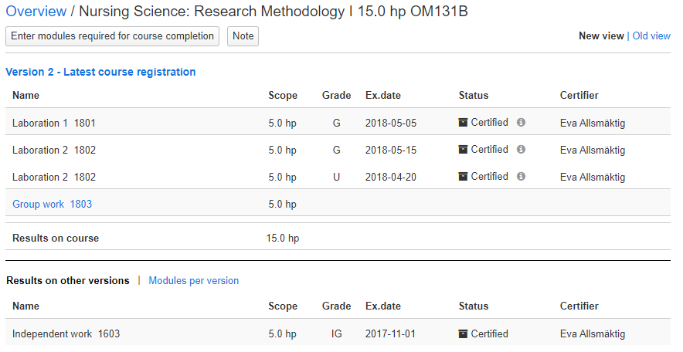
Certify a changed result
i
From 11 March 2020 it is possible to change a result (grade + examination date) that has been certified. To do this, the results first need to be prepared for change and then they need to be certified.
Note that results should only be changed if grades or exam dates have been entered incorrectly and need to be changed. If a student has previously failed, but has re-taken the examination with a passing grade, a new result should be reported.
Other changes to certified results
Title can be changed by staff with the authority to do so.
Results annotations that has been certified cannot be changed.
How to: Certify a changed result
When you need to certify a changed result, you will notified by the person preparing the change, e.g. by e-mail. You then do the following in Ladok:
Search for the student who should get a changed result
Click on the course where the result should be changed
The modules where the student has obtained results are now listed under the version of the course to which they belong. Click on the version that the module belongs to.
3
Latest update: 2020-03-06
Version of Ladok at the latest update: 1.43.0

Slide 2
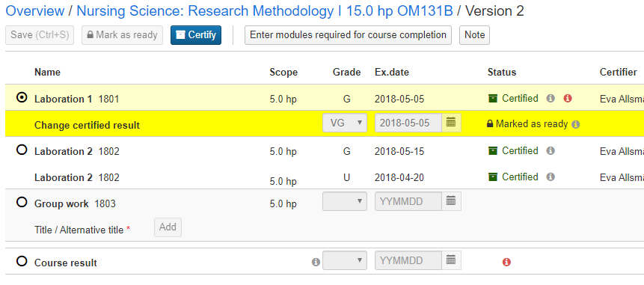
Certify a changed result (cont.)
In the row for the module you will see the grade and examination date the student has received previously. On the row beneath you will see the changed result.
Mark the module
Click Certificate
Ladok may now request that you log in again to complete the certification.
6
5
4

