Slide 1
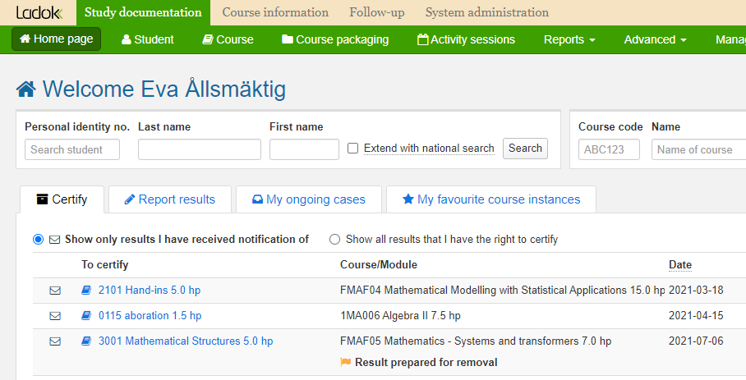
Remove certified results
i
Remove a certified result
Only the examiner who certifies on the course can remove certified results.
Keep in mind that a certified result is an official decision, there are regulations regarding how you may change certified results. Check with your university if you are unsure.
When results are removed, any results annotations (e.g. examination points) are deleted. Make sure to note these on the side if you want to save them.
Change results
If a result needs to be changed, it can be done without removing the incorrect result first. The result first needs to be prepared for change and then needs to be certified by the examiner on the course. See instructions at ladok.se.
In case someone has prepared for you to remove the results, you will receive an e-mail from Ladok. Log in to Ladok and look in the tab “Certify” on the home page – there will have a link to the results prepared for removal there.
Click on the link, then follow the instructions from step 5 on page 3.
Last updated: 2022-09-12 Version of Ladok at the latest update: 2.0.0

Slide 2
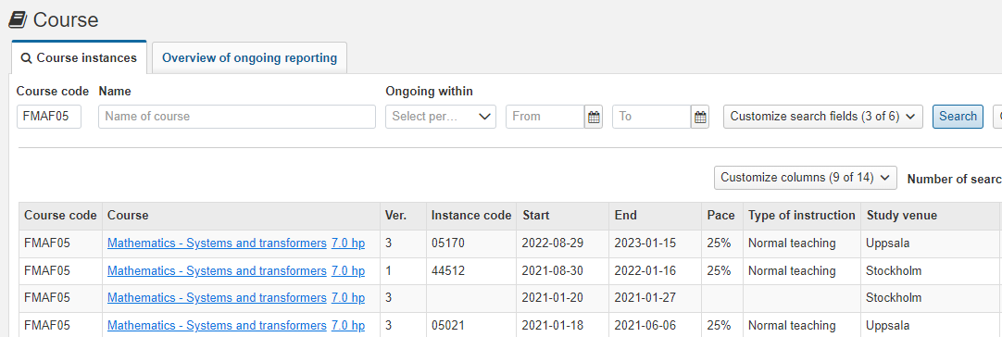
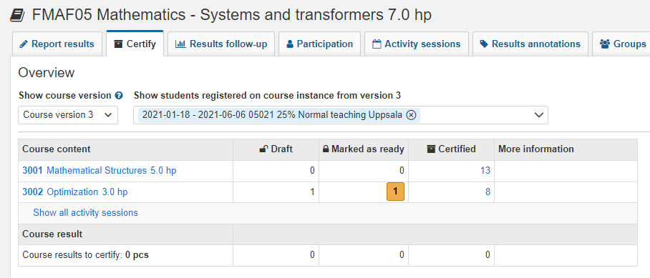
Remove certified results
You can remove certified results, even if they have not been prepared for removal. Follow the instructions below:
Search for the course instance you’re going to remove results from. For example by searching on the course code and then selecting the instance that was given during the semester.
Select the tab Certify
Click on the part of the course you’re going to remove results from
1
2
3

Slide 3
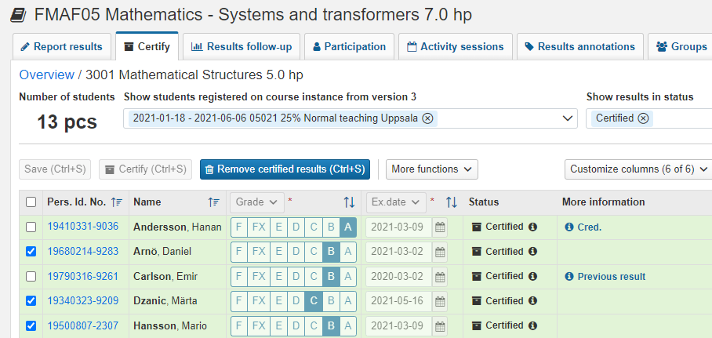
Remove certified results (cont.)
Filter the certified results in the box “Show students with results status“
Select the students whose results you want to remove and click on “Remove certified results"
Confirm in the dialog that opens. The student does not see any comment that you may write in the dialogue box.
Ladok may request that you log in again
The certified results have now been removed.
4
5
Obstacles to remove
If there are obstacles to remove the results, "Obstacles" is displayed in the "More information" column. Click on it to see more. Obstacles may be due to:
You are trying to delete a result on a module on a student who has a certified result on a course. Delete the result on the course first, then you can delete the result on the module.
The result is included in an issued diploma or course certificate

