Slide 1
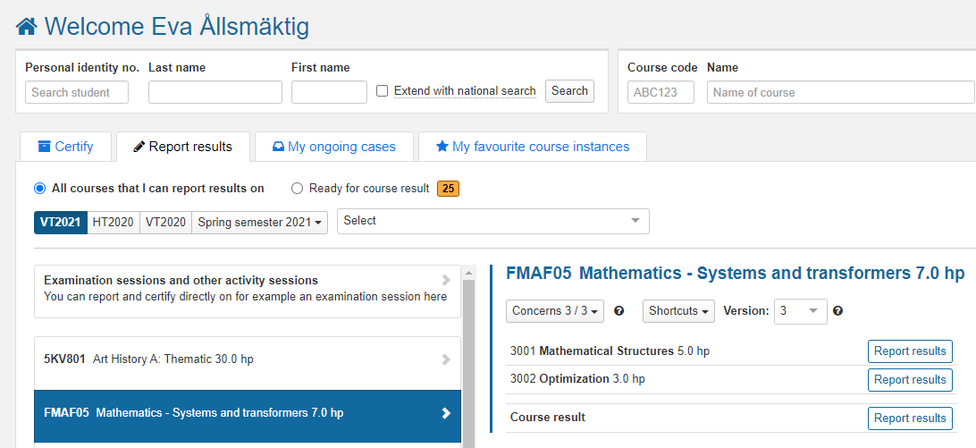
Report results on module or course
Content | Page
Report results on module | 1-3
Report results on the entire course | 4-5
Report with results annotations | 6
Report results on a module
Log in to Ladok and select the tab Report results
Click on the course you’re going to report results for
Click on Report results in the row of a module to report results on it.
1
If you need to report results on a course instance from a previous semester, select the semester here and then click on the course.
3
2
Last updated: 2022-11-21 Version of Ladok at the latest update: 2.5.0

Slide 2
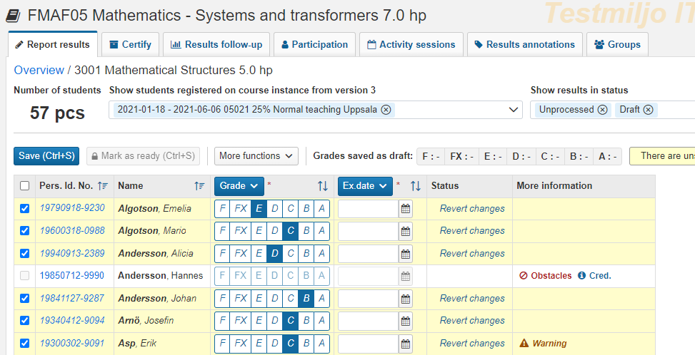
Report results on module (cont.)
You will be re-directed to a list of all students who took the course during the semester but who have not received an approved result on the module yet.
Select a grade in the row of each student that should receive a result. The students are automatically selected when you do so.
Use the "Ex. Date" button in the table header to give all selected students the same examination date. Examination date = examination date or date for the most recently completed parts.
IF the students are to have different examination dates, you can enter it in the line for each student
Save (shortcut: Ctrl + S)
The results are now saved as drafts. You can leave the page and continue at another time.
In case you are done with the reporting, go ahead and mark the results as ready.
7
6
5
Revert changes
In case you put in the wrong information, you can revert your changes for a student before you save.
More information
The column displays information that may be relevant to you when you report. Click on the texts to see more information.

Slide 3
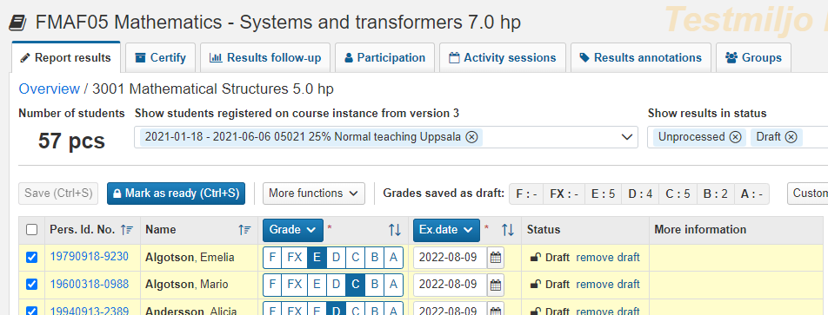
Report results on module (cont.)
Mark results as ready
Mark the students whose results should be marked as ready
Click on “Mark as ready”
In the dialogue box:
Select the teacher who graded the examination You can select users in the boxes “Authorized reporters” or “Users at the university”, if the person is not found in the list you can write in the box “Other”
Select which examiner should be notified that certification is pending. Only examiners who have the right in Ladok to certify the results can be selected.
Click on Mark as ready and notify
The results are now marked as ready and can only be handled by the person who certifies on the course. The examiner will within 30 minutes receive an e-mail about the results.
i
Mark as ready = You prepare the results to be certified by the examiner. The results are locked and can no longer be changed by the person who only reports on the course.
The results (grades + examination date) must be saved as drafts to be marked as ready.
Summation of grades
Grades saved as drafts are summed up here.
9
8
10

Slide 4
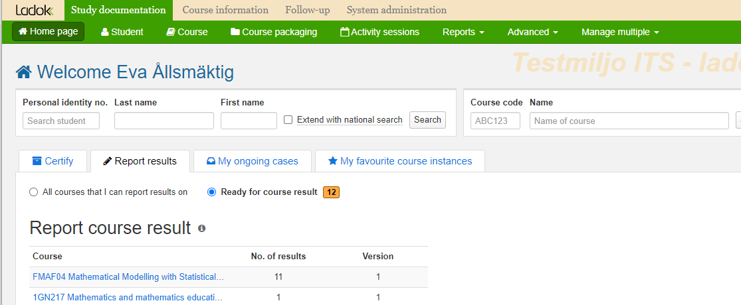
Report results on the entire course
i
When a student has passed, certified results on all compulsory modules in the course, you need to report an overall result on the entire course.
Find students to report results on course
You will get a notice on the home page of Ladok when there are results on the entire course to report.
Depending on what settings have been made for you in Ladok, it is possible that you will receive an email notification when you can report results for the entire course. Regardless of whether you receive an email notification or not, the reporting is done by:
Report results on the entire course and save
Select Ready for course results on the home page
Click on the course you are going to report results on
1
2

Slide 5
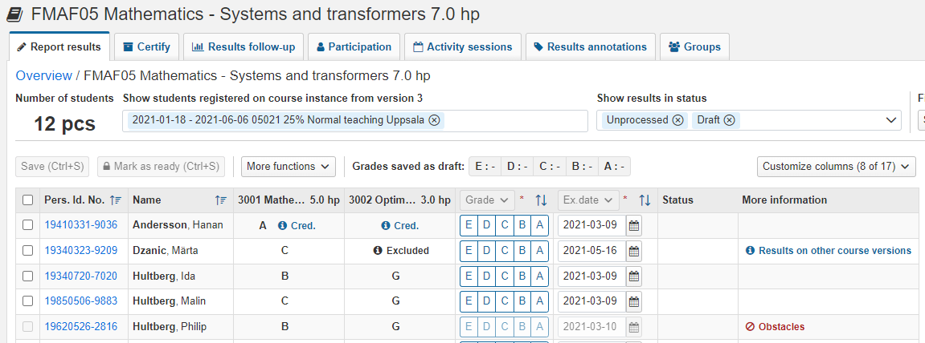
Report results on the entire course (cont.)
You will be re-directed to the reporting page for results on the entire course.
Select grades in the row of each student
You can give the students the same grade on the entire course as they have on a module by: selecting the students, clicking on “More functions" → "Copy grade from module" *.
Examination date has been automatically entered as the same date as the latest module result. You may change to a later date if needed.
Save as draft (shortcut: Ctrl + S)
Mark as ready, select the grading teacher and notify the examiner who should certify the results.
The results are now marked as ready and can only be handled by the person who certifies on the course. The examiner will receive an e-mail about the results.
* You can only copy module results that have the same grading scale as course results.
Show / Hide columns
You can control which columns are displayed, click on "Customize columns" to e.g. hide modules that are not relevant to you now.
5
6
4
“CRED.“
If all or parts of the module have been credited, “CRED" is displayed. Click on the text to see more information.
“EXCLUDED“
If a module is marked with “Excluded", it means that the student has received results from different course versions. Click on “Results on other course versions” in the column “More information” to see all grades.

Slide 6
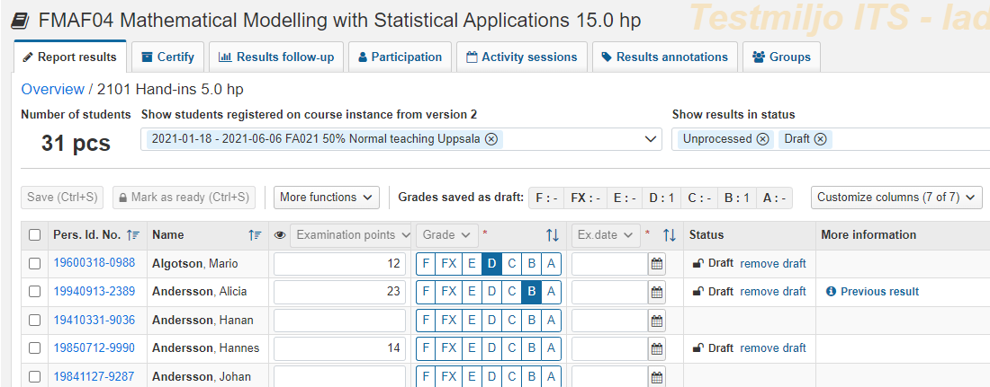
Report with results annotations
i
Results annotations are a type of note that can support your reporting in Ladok. Notes can be reported continuously during the course. When grades and / or examination dates are to be reported, you get an easy overview of the student's participation through the notes.
New results annotations are created in the tab "Results annotations". Once they are created, you can report on them according to the instructions below.
Results annotations are not mandatory to fill in, and do not give any credits.
Report on results annotations
When results annotations have been created in the tab "Results annotations ", they are added to columns in your reporting list
Report a note by:
Fill in the note in the row of each student or
Select several students and fill in the note through the button in the table header
Save as draft (shortcut: Ctrl + S)
The note that you reported is saved.
When you report grades and examination dates at a later time, you can use the notes as support.
Show/hide results annotations?
Click on "Customize columns" to choose which ones you see!
2
1
Visible to student
Results annotations marked with an eye will be visible to the student when the result has been certified.
Previous results annotations
E.g. a re-registered student or students who have received a failed grade earlier may have a results annotation reported previous. This is indicated in the column "More information“ with the text “Previous results“.

